Slide 1
Intro to coding a FRC robot
Jim Wright
FRC 4089 STEALTH

Slide 2
What are we going to do?
We are going to look at subsystems and controls
https://github.com/JimWright4089/FIRSTWorkshops

Slide 3
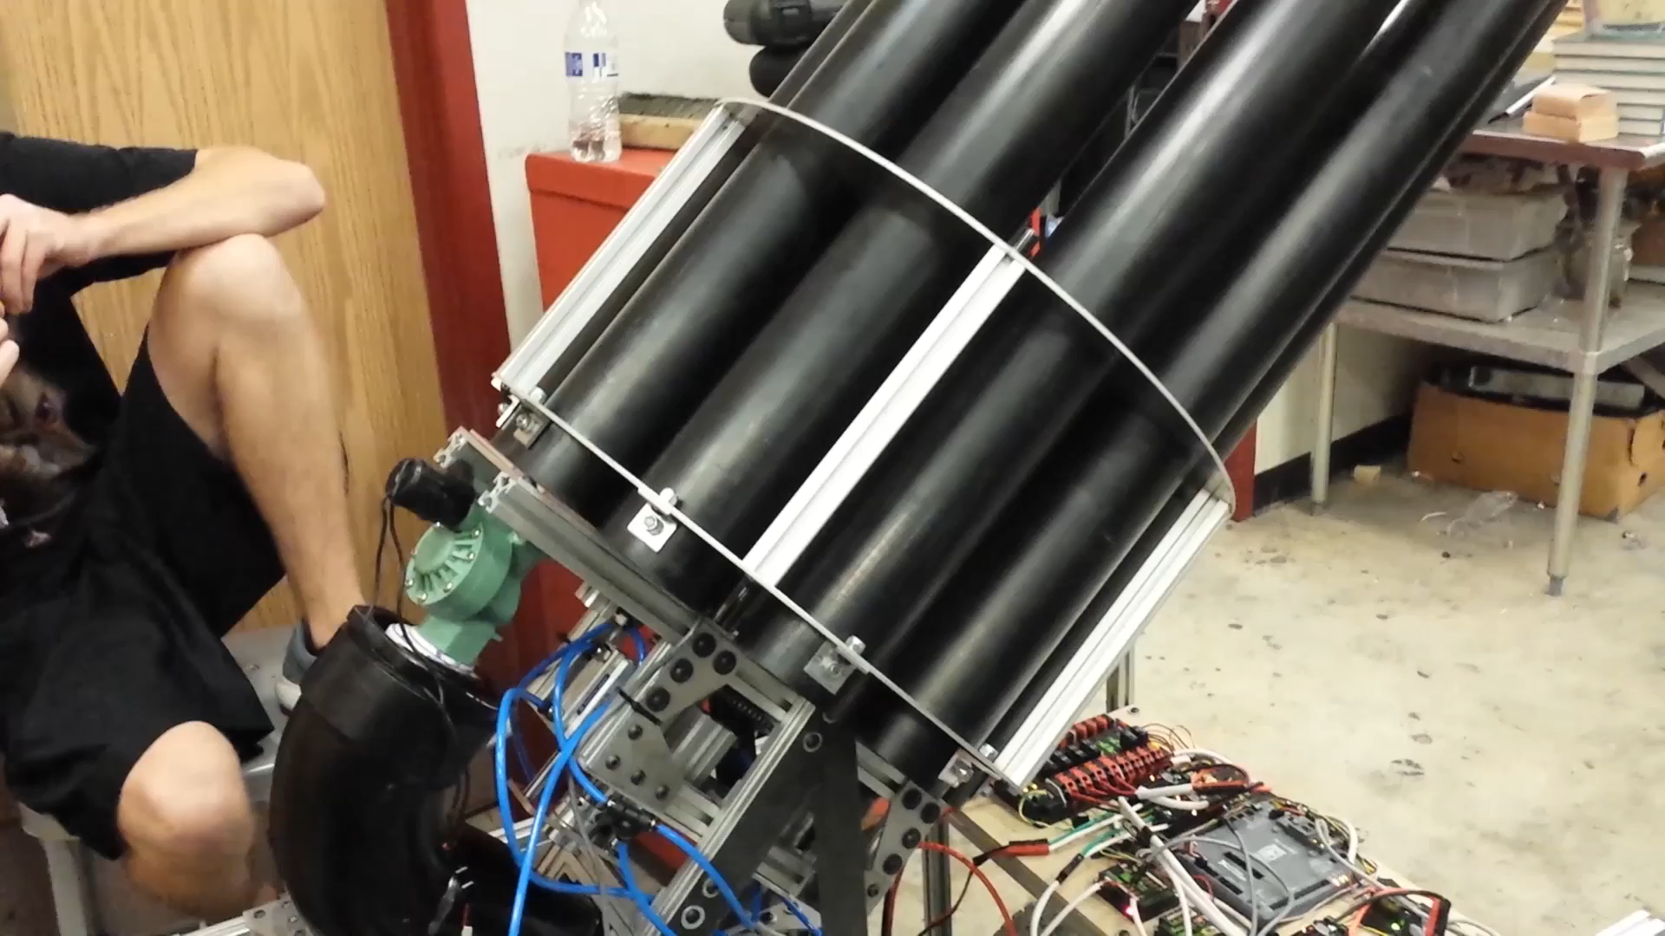
Stealth T-Shirt cannon
https://github.com/JimWright4089/FIRSTWorkshops

Slide 4
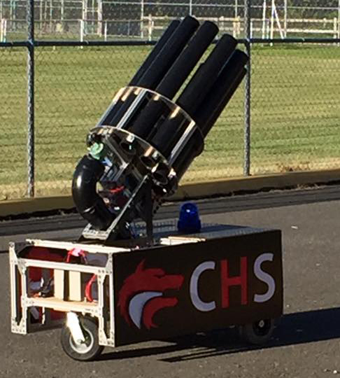
Two Subsystems
Drive Base
Cannon
https://github.com/JimWright4089/FIRSTWorkshops

Slide 5
Drive Base
Four motor base
public static CANTalon driveRightDrive;
public static CANTalon driveLeftDrive;
public static CANTalon driveRightDriveB;
public static CANTalon driveLeftDriveB;
static int kRightMotorA = 1;
static int kRightMotorB = 2;
static int kLeftMotorA = 3;
static int kLeftMotorB = 4;
driveRightDrive = new CANTalon(kRightMotorA);
driveRightDriveB = new CANTalon(kRightMotorB);
LiveWindow.addActuator("Drive", "RightDrive", driveRightDrive);
driveLeftDrive = new CANTalon(kLeftMotorA);
driveLeftDriveB = new CANTalon(kLeftMotorB);
LiveWindow.addActuator("Drive", "LeftDrive", driveLeftDrive);
https://github.com/JimWright4089/FIRSTWorkshops

Slide 6
TALON SRX
In 2018 Cross the Road Electronics pulled it’s libraries out of the WPI library.
If you are using anything from CTRE you need to install the Phoenix Libraries from cross the road.
The CANTalon class is now from import com.ctre.*;
As is the Pneumatic control as well as the Power Distorbution board.
https://github.com/JimWright4089/FIRSTWorkshops

Slide 7
Drive Base
The second motor is chained to the main one
driveRightDrive.set(0);
driveRightDriveB.changeControlMode(CANTalon.TalonControlMode.Follower);
driveRightDriveB.set(kRightMotorA);
driveLeftDrive.set(0);
driveLeftDriveB.changeControlMode(CANTalon.TalonControlMode.Follower);
driveLeftDriveB.set(kLeftMotorA);
driveRobotDriveMotors = new RobotDrive(driveLeftDrive, driveRightDrive);
https://github.com/JimWright4089/FIRSTWorkshops

Slide 8
Drive subsystem
Drive is simple, it has one method in it ‘Drive’
public void Drive(Joystick driveJoystick) {
double y = driveJoystick.getY();
double z = driveJoystick.getZ();
robotDriveMotors.arcadeDrive(y, z);
}
https://github.com/JimWright4089/FIRSTWorkshops

Slide 9
Cannon
A lot more complex
Barrel goes in one out
Barrel turns
Air chamber fills
Air is released
Warning Light
https://github.com/JimWright4089/FIRSTWorkshops

Slide 10
Cannon Controls
The trigger will shoot a T-Shirt, change barrel, charge tank, and light the blue light
A button will push the barrel out
A button will pull the barrel in
A button will rotate the barrel until the button is released.
A button will shoot
A button will fill the tank
https://github.com/JimWright4089/FIRSTWorkshops

Slide 11
Cannon Subsystem
public void zeroEncoder()
public void initDefaultCommand()
public void startShoot()
public void shoot()
public boolean isShootDone()
public void startBarreling()
public void setBarrelIn()
public void setBarrelOut()
public boolean isBarrleIn()
public boolean isBarrleDone()
public void startCharging()
public void charge()
public boolean isCharged()
public void zeroBarrels()
public void setNextBarrel()
public void rotate()
public boolean isNextBarrel()
public void startRotate()
public void stopRotate()
https://github.com/JimWright4089/FIRSTWorkshops

Slide 12
Commands
AutomatedFire
BarrelsIn
BarrelsOut
ChargeTank
Rotate
RotateUntilLimit
Shoot
https://github.com/JimWright4089/FIRSTWorkshops

Slide 13
Automated fire
automatedFireButton = new JoystickButton(utilityJoystick, 1);
automatedFireButton.whenPressed(new AutomatedFire());
public AutomatedFire() {
addSequential(new Shoot());
addSequential(new BarrelOut());
addSequential(new ChargeTank());
addParrellel(new RotateUntilLimit());
addSequential(new BarrelIn()); }
https://github.com/JimWright4089/FIRSTWorkshops

Slide 14
RotateUntilLimit
public class RotateUntilLimit extends Command {
StopWatch mWatcher = new StopWatch(15000);
public RotateUntilLimit() {
requires(Robot.cannon);
System.out.println("RUL cons");
}
protected void initialize() {
System.out.println("RUL init");
mWatcher.reset();
Robot.cannon.startBarreling();
Robot.cannon.setBarrelOut();
Robot.cannon.setNextBarrel();
}
https://github.com/JimWright4089/FIRSTWorkshops

Slide 15
RotateUntilLimit
// Called repeatedly when this Command is scheduled to run
protected void execute() {
if(true == Robot.cannon.isBarrleDone())
{
Robot.cannon.rotate();
}
}
https://github.com/JimWright4089/FIRSTWorkshops

Slide 16
RotateUntilLimit
protected boolean isFinished() {
boolean gotToNext = (Robot.cannon.currentBarrel == Robot.cannon.nextBarrel);
boolean stopWatchFinished = mWatcher.isExpired();
if((true == stopWatchFinished) || (true == gotToNext))
{
Robot.cannon.stopRotate();
System.out.print("Watch:");
System.out.print(stopWatchFinished);
System.out.print(" Next:");
System.out.println(gotToNext);
return true;
}
return false;
//return Robot.cannon.isLimitPressed();
}
https://github.com/JimWright4089/FIRSTWorkshops

Slide 17
RotateUntilLimit
protected void end() {
System.out.println("RUL end");
Robot.cannon.stopRotate();
Robot.cannon.reachedNextBarrel = false;
}
// Called when another command which requires one or more of the same
// subsystems is scheduled to run
protected void interrupted() {
System.out.println("RUL intr");
end();
}
https://github.com/JimWright4089/FIRSTWorkshops

Slide 18
setBarrelIn
public void setBarrelIn() {
// Check if safe to barrel in
if(true == isSafeToBarrleIn) {
if(true == boolBarrleDebug) {
boolBarrleDebug = false;
System.out.println("Barrel In");
}
isBarrelIn = true;
barrelExtender.set(true);
}
else {
if(true == boolBarrleDebug) {
boolBarrleDebug = false;
System.out.println("Not Safe to Barrel In");
}
isBarrelIn = false;
}}
https://github.com/JimWright4089/FIRSTWorkshops

Slide 19
Robot
public void robotInit() {
RobotMap.init();
drive = new Drive();
cannon = new Cannon();
oi = new OI();
}
https://github.com/JimWright4089/FIRSTWorkshops

Slide 20
Robot
public void teleopInit() {
// This makes sure that the autonomous stops running when
// teleop starts running. If you want the autonomous to
// continue until interrupted by another command, remove
// this line or comment it out.
if (autonomousCommand != null) autonomousCommand.cancel();
}
/**
* This function is called periodically during operator control
*/
public void teleopPeriodic() {
Scheduler.getInstance().run();
}
https://github.com/JimWright4089/FIRSTWorkshops

Slide 21
StopWatch
public class StopWatch
{
long mLastTime = 0;
int mWaitTime = 0;
public StopWatch(int waitTime)
{
mWaitTime = waitTime;
}
public void setTime(int waitTime)
{
mWaitTime = waitTime;
}
https://github.com/JimWright4089/FIRSTWorkshops

Slide 22
StopWatch
public boolean isExpired()
{
if((System.currentTimeMillis()-mLastTime)>mWaitTime)
{
return true;
}
return false;
}
public void reset()
{
mLastTime = System.currentTimeMillis();
}
}
https://github.com/JimWright4089/FIRSTWorkshops

Slide 23
Log File
private FileWriter mLogFile;
mLogFile = new FileWriter("/home/lvuser/drivePath.csv", true);
mLogFile.write("\n");
mLogFile.write("\n");
mLogFile.write("Event:"+DriverStation.getInstance().getEventName()+"\n");
mLogFile.write("Match Number:"+DriverStation.getInstance().getMatchNumber()+"\n");
mLogFile.write("Replay Number:"+DriverStation.getInstance().getReplayNumber()+"\n");
mLogFile.write("Game Data:"+DriverStation.getInstance().getGameSpecificMessage()+"\n");
mLogFile.write("\n");
mLogFile.close();
https://github.com/JimWright4089/FIRSTWorkshops

